Slide 1
VOLUNTEER PLACEMENT PROJECT
Our aim is to create a streamlined, effective pathway towards sustainable, long-term volunteer placements that provide opportunities for refugees and asylum seekers to connect with their local community

Slide 2
We currently have 7 sanctuary seekers volunteering with 3 different organisations in Manchester. We have also connected healthcare professionals to Auxilium Social Enterprise to help them get the training and experience they need to practice in the UK.

Slide 3
Our sanctuary seekers have a range of tasks when they volunteer...
I work on the till at the shop
I patrol the galleries in the museum
I welcome visitors to the museum
I sort out products and donations

Slide 4
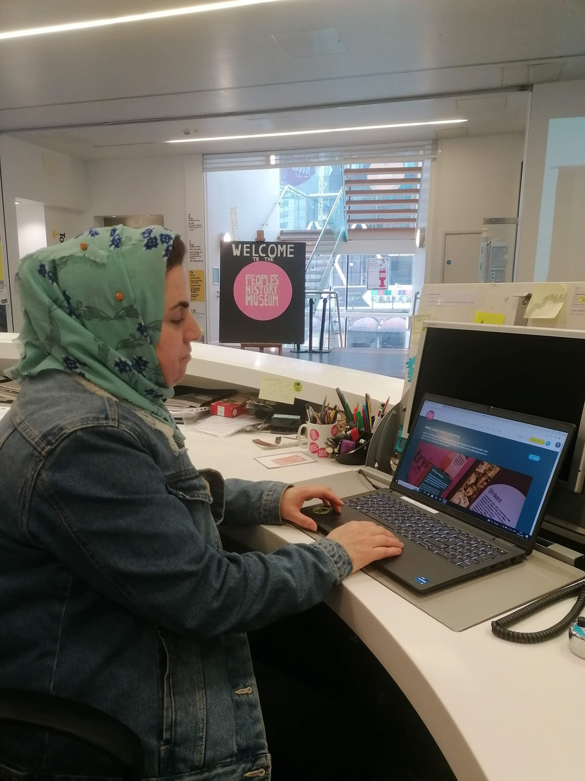
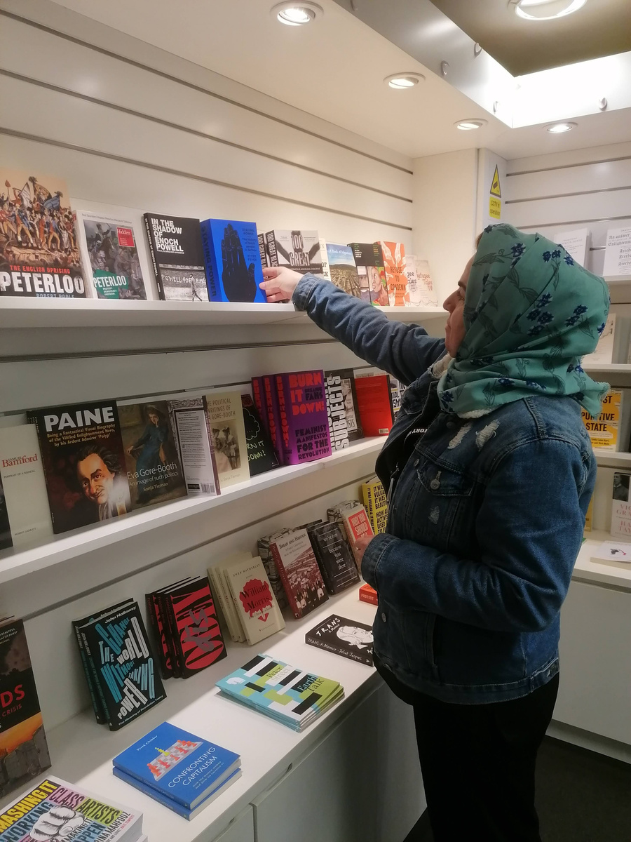
VOLUNTEER PLACEMENT PROJECT
Kurdistan at People's History Museum

Slide 5
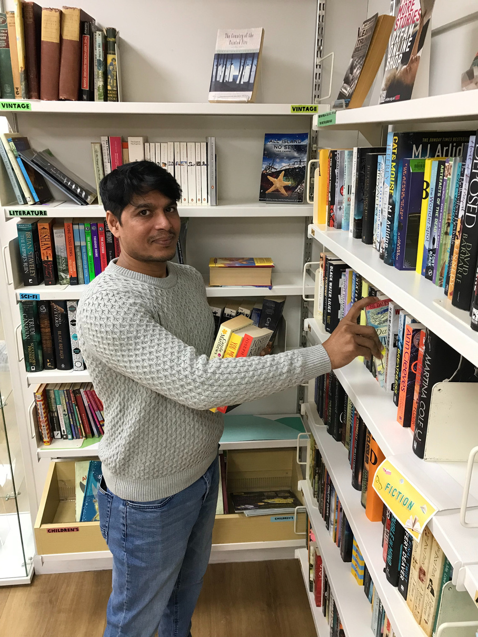
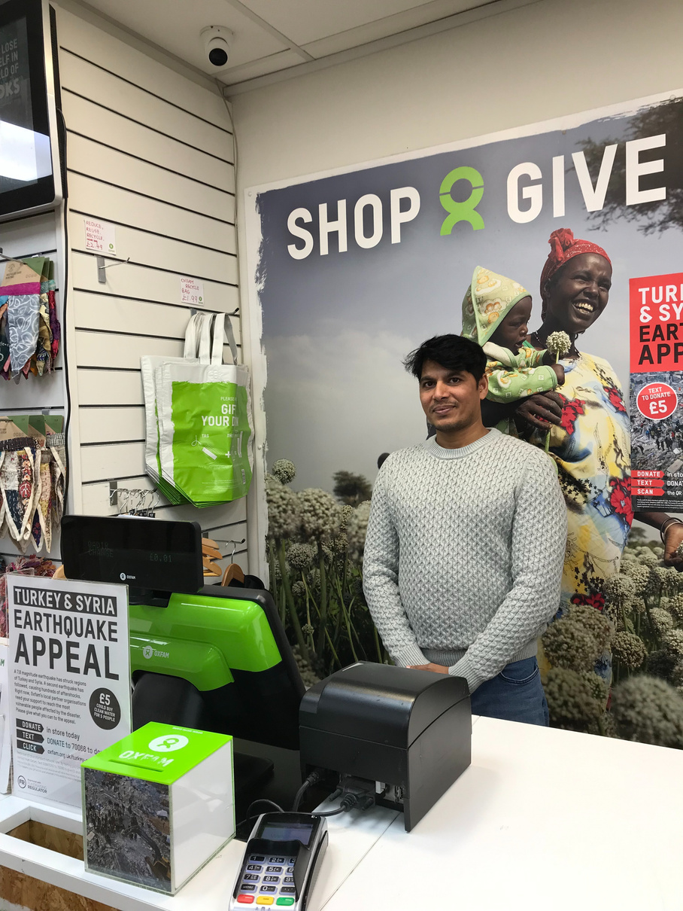
VOLUNTEER PLACEMENT PROJECT
Qadir at Oxfam

Slide 6
"I can meet new people and find friends"
All of the people who have taken part in our project say they have enjoyed it. Here are some reasons why...
"I have improved my work skills and got experience"
"I have learnt how to work with other people"
"It has grown my confidence and communication skills"
"It is a very good opportunity to practice the English language"

Slide 7
All of the organisations we have partnered with would recommend the MCoS Volunteer Placement Project to others. They said...
You will receive all of the support you need from MCoS
It's so rewarding seeing Sanctuary Seekers benefit from the placement
It is a fantastic project and so beneficial to everyone involved
Volunteers bring such a wealth of knowledge and skills

