Slide 1
Communicating Help for Households and Cost of Living Payments
Stakeholder Toolkit including:
- downloadable poster and ordering instructions - social media copy in English and Welsh - newsletter copy, FAQs and links - factsheet

Slide 2
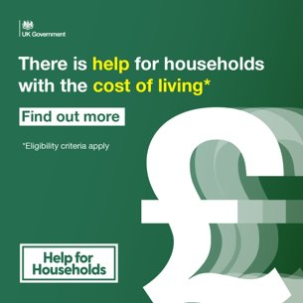
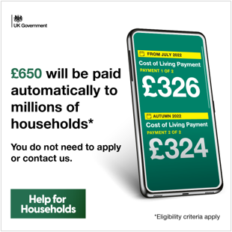
How to talk about Help for Households and the Cost of Living Payments
​The Government is providing £37 billion this year to help households combat the rising cost of living.
We know this may lead to questions about how much people may be entitled to.​ ​ This toolkit sets out ​ - what the different payments are and when they will start being paid​ - who is eligible for the payments​ - how stakeholders can support their customers
​Example social media copy and assets for use on your channels
Cost of Living Payment Households may receive £650 if they are on means tested benefits, including #UniversalCredit and #PensionCredit
Check eligibility here: Cost of Living Payment - GOV.UK (www.gov.uk)
Click here for our full asset pack including social media assets and suggested social copy
Contact external.affairs@dwp.gov.uk for more information

Slide 3
Suggested social media copy
If you are claiming a low-income benefit and think that you are entitled to a Cost of Living Payment, you don't need to do anything. You'll get the payments automatically. To find out more visit: Cost of Living Payment - GOV.UK (www.gov.uk)
The first instalment of the £650 Cost of Living Payments will be paid automatically to eligible people, between 14 - 31 July. The remaining £324 will be paid in autumn. To find out more visit: Cost of Living Payment - GOV.UK (www.gov.uk)
Did you know that households on means tested benefits, including Universal Credit and Pension Credit, may receive a payment of £650 this year? This will be made automatically in two instalments - the first £326 of which will be paid between 14 - 31 July. To find out more visit: Cost of Living Payment - GOV.UK (www.gov.uk)
More social media posts are available by clicking the link here

Slide 4
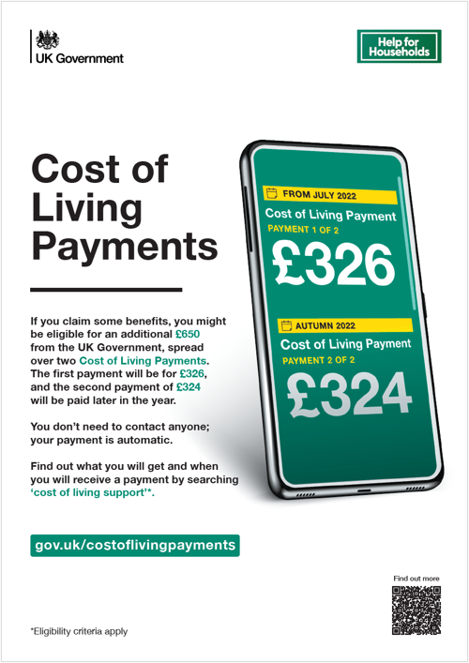
Newsletter copy and leaflet/poster
Newsletter copy | Poster for stakeholders
Millions of people on means-tested benefits will receive the first of two Cost of Living Payments totalling £650 from 14 July 2022, as part of a £37billion government package to help families with cost of living pressures. The first £326 instalment for qualifying low-income households in England, Wales, Scotland and Northern Ireland will be paid by their usual payment method from 14 July 2022, continuing to the end of the month. For those eligible, the rest will follow in a second instalment in the autumn. People receiving tax credits and no other eligible benefits will receive their first payment from HMRC in autumn and the second in winter. In total, millions of vulnerable households will receive at least £1,200 from the Government this year to help cover rising costs. There are specific payments for those on means tested benefits, for pensioners, those on disability benefits and to help people with energy bills. Check eligibility here: https://gov.uk/government/publications/cost-of-living-support/cost-of-living-support-factsheet-26-may-2022 There is also helpful information about further support available on the Cost Of Living campaign website.
Click here for the newsletter copy and poster, and translated versions in Welsh

Slide 5
Help for Households - What people need to know
Need to know more? Our factsheet can help provide more answers
More than eight million people on means-tested benefits will receive a payment of £650 this year, made in two instalments. This includes all eligible households receiving at least 1 pence on the qualifying date of the following benefits; Universal Credit, Income-based Jobseekers Allowance, Income-related Employment and Support Allowance, Income Support, Pension Credit, Working Tax Credit and Child Tax Credit
The first payment of £326 will be made to households in payment of a qualifying benefit between April 26 and May 25 from July 14, with a further £324 to be paid from September – totaling £650. For eligible households on tax credits only, the first payment will be made in the autumn and the second in the winter. Payments will be made automatically via usual payment methods – people do not need to contact HMRC or DWP or apply for the payment (Read more)
There will also be a £150 payment made to people on qualifying disability benefits which can be in addition to the above due to be paid in September
There will also be an extra £300 for pensioner households paid as an increase to their winter fuel payment to be paid from mid-November
In addition to these payments, there is also the Energy Bills Support Scheme which will see all domestic energy customers receive a one-of rebate of £400 paid by their energy providers. This money will not need to be paid back
Households liable for Council Tax in Bands A-D in England have received a £150 Council Tax Rebate to help with the rising cost of bills (Read more)
And the government has also extended the Household Support Fund until March 2023, providing an extra £421million of local support in England and £79 million to the Devolved Administrations (Read more)

Slide 6
What you need to know at a glance
Payment | Date to be paid | Eligibility | More information
Cost of Living Payment, totalling £650, for those on low income means- tested benefits | First payment of £326 will be paid from July 14 with a second payment of £324 to be paid in the Autumn – totalling £650 | People on an eligible benefit in payment on each qualifying date. These benefits are: Universal Credit Income-based Jobseeker’s Allowance (JSA) Income-related Employment and Support Allowance (ESA) Income Support Pension Credit | More information
Cost of Living Payment, totalling £650, for those on Tax Credits only | First payment of £326 will be paid from Autumn 2022 with a second payment of £324 to be paid Winter 2022 – totalling £650 | For eligible households receiving tax credits on each qualifying date. It is possible for customers to be entitled to both tax credits and other eligible benefits. So HMRC will make payments to eligible customers receiving tax credits only, shortly after DWP paying to all those on other benefits, to avoid duplicate payments. | More information
One-off disability payment of £150 | September 2022 | People on an eligible disability benefit in payment on any day between April 26 and May 25 2022 will receive a one-off payment of £150 in September. Click the link to see who is eligible. | More information
One-off £300 increase to Winter Fuel Payment | As part of Winter Fuel Payment from mid-November | This one-off increase go to more than 8 million pensioner households across the UK who receive the Winter Fuel Payment and will be paid on top of any other one-off support an eligible pensioner household is entitled to. | More information

Slide 7
Frequently asked questions
The attached factsheet should help you assist – in addition, the following top-level FAQs may answer any questions:
Q: How do people apply for these Cost of Living Payments?
A: People do not need to apply for Cost of Living payments. If they are eligible, they will be paid automatically in the same way that they usually receive their benefit or tax credits.
Q: Will these payments affect other benefits?
A: These payments are not taxable and will not affect the benefits or tax credits people already receive.
Q: How will people know they are eligible? What are the qualifying dates and requirements?
A: To get the first Cost of Living Payment of £326, people must have been entitled to a payment (or later found to be entitled to a payment) of either Universal Credit for an assessment period that ended in the period 26 April 2022 to 25 May 2022 or income-based JSA, income-related ESA, Income Support or Pension Credit for any day in the period 26 April 2022 to 25 May 2022. For Tax Credit customers – To get the first Cost of Living Payment of £326, customers must have received a payment, or an annual award of at least £26, of tax credits for any day in the period 26 April 2022 to 25 May 2022. GOV.UK will be updated when the qualifying dates to get the second payment of £324 have been announced by the Government.
Q: When will the second cost of living payment be paid?
A: We will be communicating with customers when payment dates for the second payment of £324 are confirmed, but we expect this to be by the end of September 2022. Eligible customers receiving tax credits only, will receive their second payment in Winter 2022.
Q: Why are the two amounts, of £326 and £324, slightly different?
A: This will help people to know they have received both payments and avoid the risk of fraud and duplicate payments.
Q: What if a customer gets child tax credit and working tax credit?
A: If you get both Child Tax Credit and Working Tax Credit, you will receive one set of Cost of Living Payments, linked to Child Tax Credit only.
Q: I get additional benefits. Will this affect how much I get?
A: If you receive tax credits from HMRC or a qualifying low income benefit from DWP, you will receive a Cost of Living Payment from DWP or HMRC. If you also get a qualifying disability benefit, you may receive an additional Disability Cost of Living Payment from DWP.
Q: Why are tax credits customers getting paid later?
A: It's possible for customers to be entitled to both tax credits and other eligible benefits which are administered by DWP. So, HMRC will make payments to eligible customers receiving tax credits only, shortly after DWP, to avoid duplicate payments.

Slide 8
Useful links
Download files to support customers here
Use the HM Gov benefits checker to find out what you might be entitled to
Use an independent benefits calculator to find out what benefits you could get
DWP Press Release
Independent News Article: Can I get the £650 cost of living payment?
Cost Of Living Factsheet
Cost Of Living campaign website
You may be able to get other kinds of support, including:
help from the Household Support Fund from your local council in England
Pension Credit calculator
Understanding Universal Credit
the Discretionary Assistance Fund in Wales
a Crisis Grant or Community Care Grant in Scotland
Discretionary Support or a Short-term Benefit Advance in Northern Ireland

