Slide 1
Be Well - Social Prescribing Manchester
July 21

Slide 2
How the service is organised
bewell.mcr@nhs.net – 0161 470 7120
Neighbourhood Be Well Teams
Coaches
Link Workers
Employment Coaches
In Work Coaches
Debt, benefits and housing speaclists
PCN Social Prescribing Teams

Slide 3
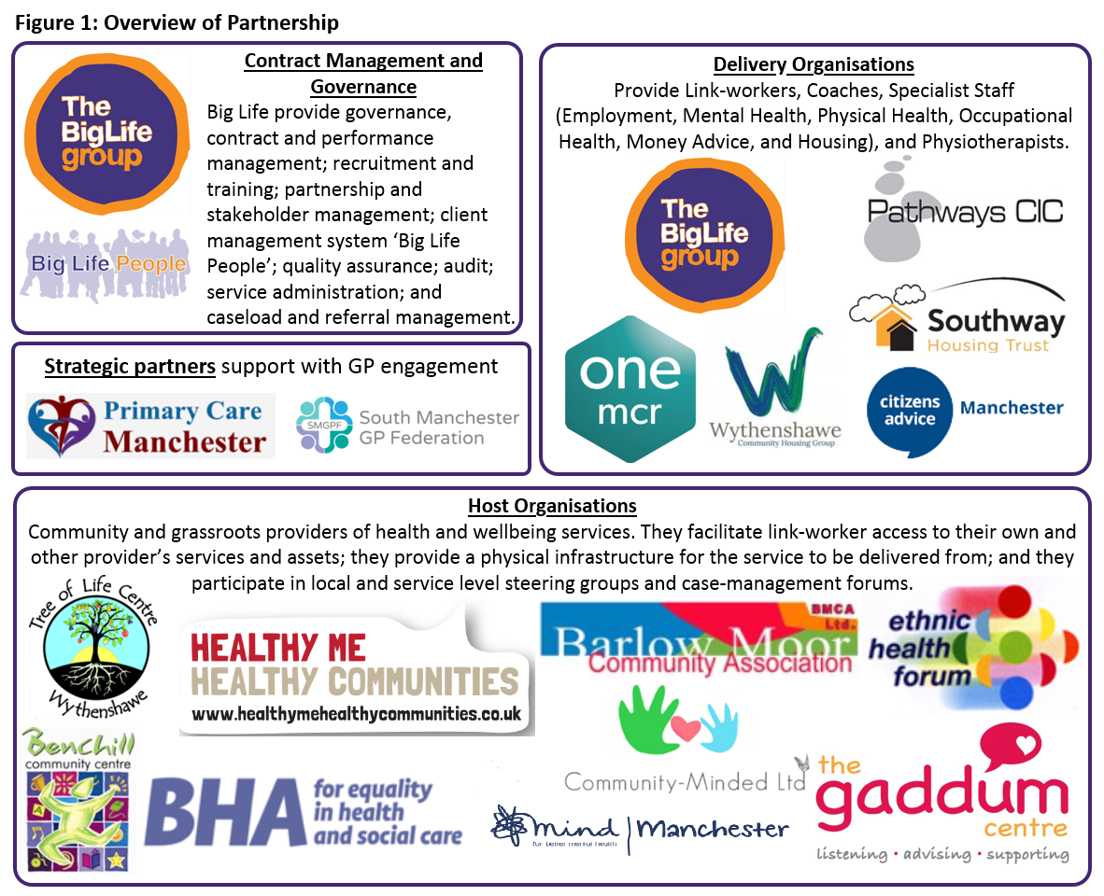

Slide 4
Some figures: Jan 2019 – Feb 2021
Notes:
Referral data shows that the Be Well services have effectively developed referral pathways across the city which have enabled us to receive 11,000+ referrals to date. The impact of the COVID-19 lockdowns can be seen in the reduced referrals in 2020/21.
It should be noted that the figures in North in its first year of being delivered by Big Life are higher than the first year of delivery within Central and South despite the service transfer occurring during the first COVID-19 lockdown.
Key-points regarding this data include:
Incomplete years: The service commenced part way through 2018/19, therefore, the period shown is from November – March. The 2020/21 data is up to January 25^{th.}
Conversion from referral to assessment is lowest in year 2. In this year we experienced rapid growth in referral numbers, resulting from the development of positive relationships with GPs. However, a large proportion of people referred turned down support. We successfully addressed this issue through adapting our communication with GPs. This involved:
Targeting GP practices with the highest rate of referred patients that refused service.
A communications plan to provide greater emphasis and clarity about what Be Well offers, and what clients should expect.
A refresh of the literature provided to people referred by their GP.
The impact of this work is seen in an improved conversion rate in year 3. Further analysis of conversion rates from referral to various client journey milestones is provided later in the document.

Slide 5
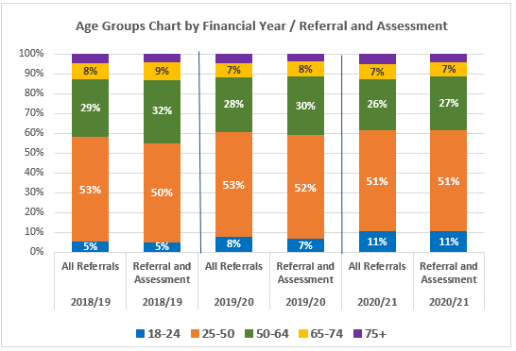
Demographics
Notes:
Firstly, it is important to note that the diversity of people accessing the service does not drop between referral and assessment, showing our ability to engage across demographics and communities of interest. On the whole, the demographic make-up of clients shows little variation year-on-year. However, in the past year the data suggests that we have received higher rates of referrals from people that are white, heterosexual and who do not report disabilities. It may be that this is due to these groups being less affected by the pandemic and the manner in which Be Well has responded to it. For example, our offer of telephone rather than face-to-face appointments may have reduced engagement as a result of being less accessible or appealing to people with language barriers or communication needs. This is in keeping with what we know about COVID-19; that the pandemic appears to impact on minority groups more. However, as the service processes have matured the proportion of people recorded as ‘other’ has reduced, and this may also be a contributing factor.
Be Well does not take self-referrals. Therefore, our impact on the population accessing the service is achieved through targeting referral partners who work with communities of geography or interest. We feel, as part of the Covid-19 recovery for the City, that there is an argument to do direct engagement with communities disproportionately affected by Covid-19 to make sure that engagement with services is maximised for those that need it.

Slide 7
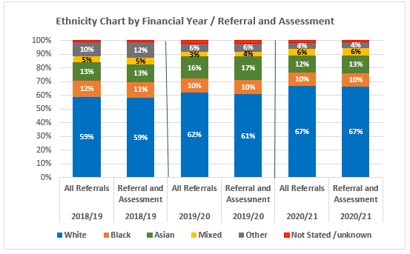

Slide 8
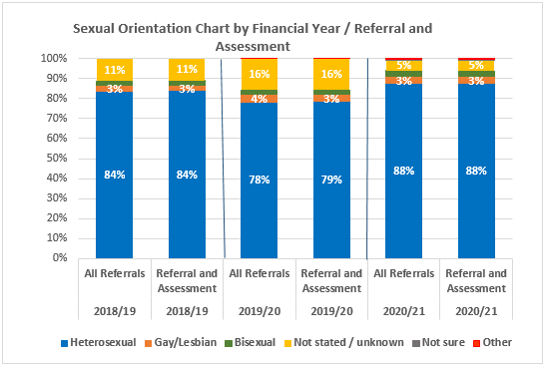

Slide 9
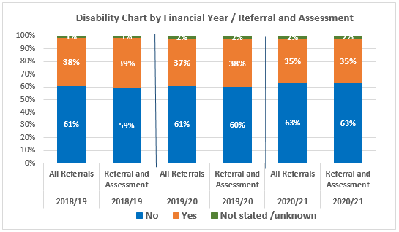

Slide 10
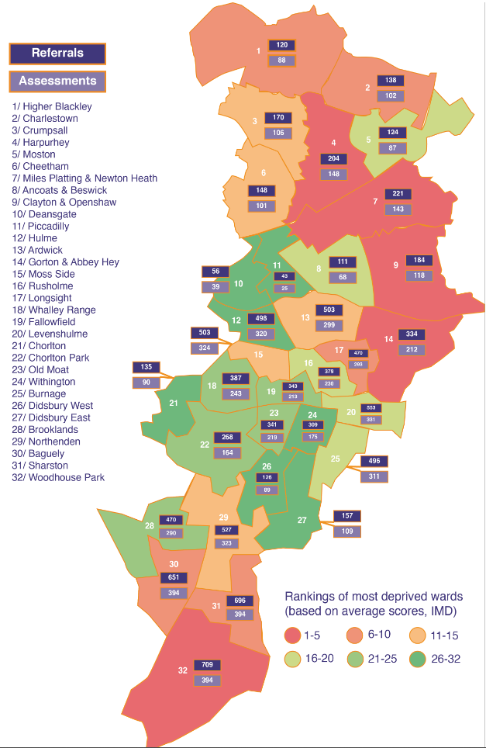

Slide 11
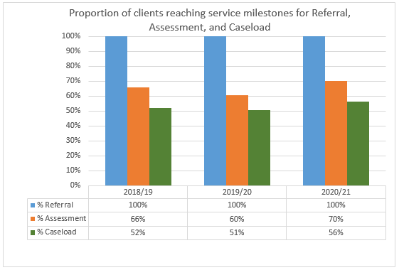
Caseload and sessions
Notes:
The data shows that between 60% and 70% of referrals reach assessment with the majority of those assessed returning for at least one follow-up appointment; this was 57% of referrals to date in 2020/21. Be Well is a voluntary service with the majority of referrals being made by GPs. We have compared our performance to a similar service, IAPT.
IAPT shares certain features with Be Well: (1) it is a voluntary service, (2) GP referrals account for a large proportion of referrals – and many self-referrals are likely to follow signposting from a GP, (3) milestones in the IAPT journey map against and can be compared to Be Well client journey milestones (Figure 12), (5) IAPT performance is published and reported at a national level, bringing a large dataset of +1.65 million referrals in the past year
Over time the average number of appointments has increased. This occurred at the same time the service worked with GPs to increase the quality of referrals. Therefore, we believe that more appropriate referrals have resulted in people being able to get more from the service and consequently stay engaged for longer. There is a smaller difference in the average number of appointments seen by link workers and coaches than we originally expected. This is reflective of the relative complexity of people seen by link-workers, who often have more needs than was expected when the service commenced. The range of appointments attended is between 1 and 30.

Slide 12
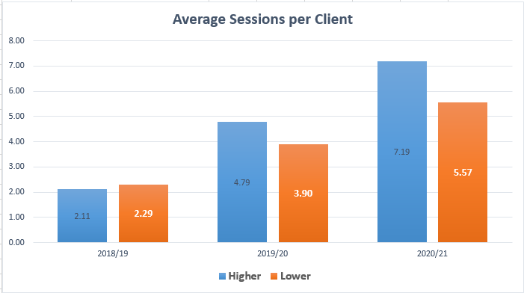

Slide 13
sWEMWBS
Notes:
Figure 1 shows that a large majority of people experience improvements to their WEMWBS scores. Warwick Medical School at the University of Warwick developed the WEMWBS scale and provide guidance on interpreting responses. At an individual level, a change of 3 or more points is suggested to be statistically significant. Figure 2 shows the proportion of people who did not achieve a change of 3 points or more, and segments those that did into bands which indicate the scale of change experienced, both positive and negative.
WEMWBS is not a tool for diagnosing depression, however comparison of WEMWBS with scales of mental illness has found a high degree of correlation. Figure 6 shows the movement between four categorisations of mental health and wellbeing suggested by WEMWBS scores provided at assessment and review. This analysis subdivides the Low Wellbeing category in figure 5 into two bandings of possible and probable depression.
This analysis shows that the 72% of people assessed experience probable or possible depression; and that this reduces to 45% at review. Of the 41% of people in the probable depression banding, less than half (17%), remain in this category after four or more sessions. The remainder are distributed evenly between possible depression and the other higher categories.

Slide 14
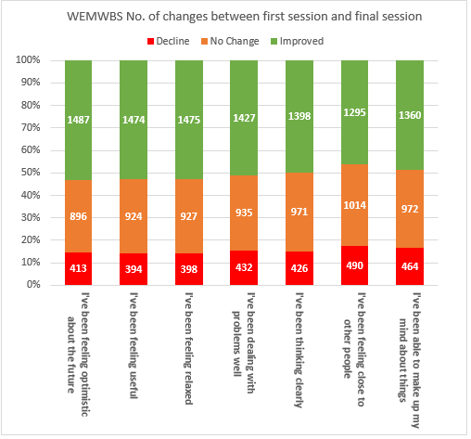

Slide 15
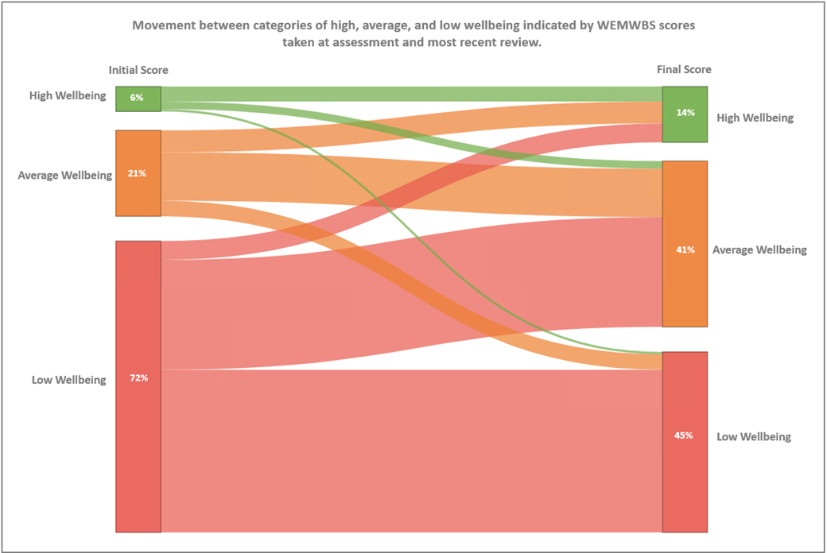

Slide 16
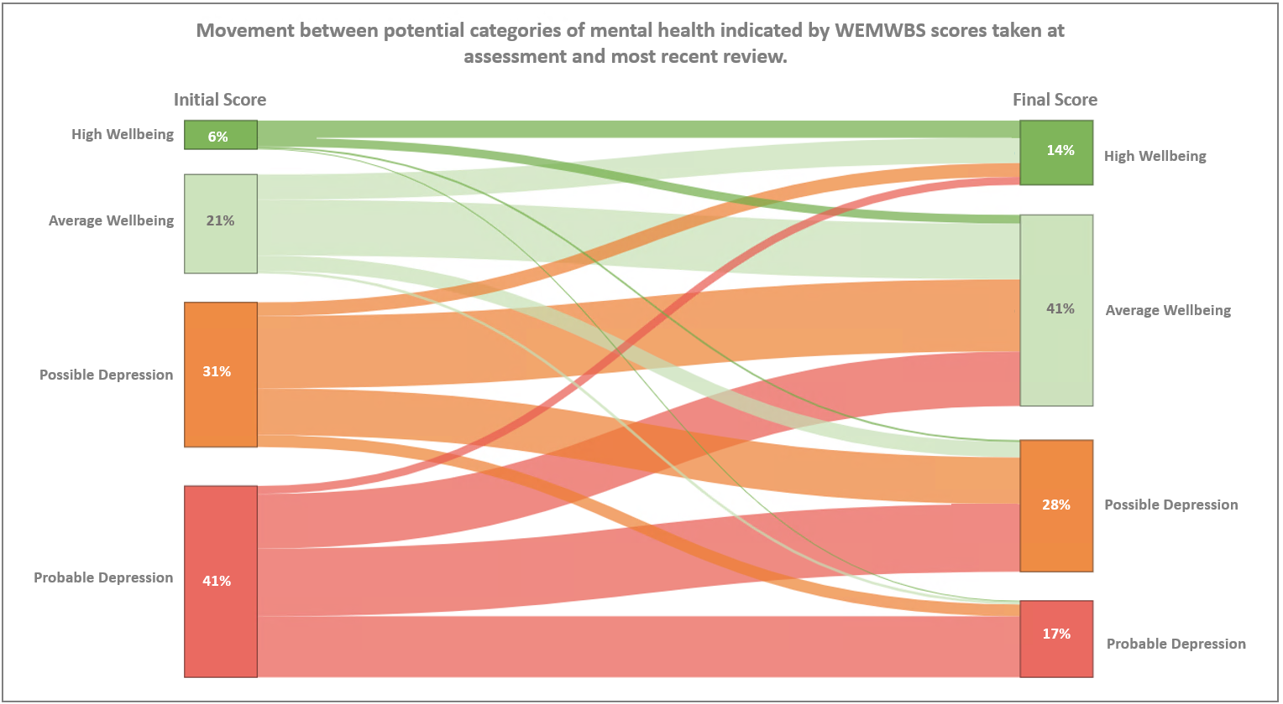

Slide 17
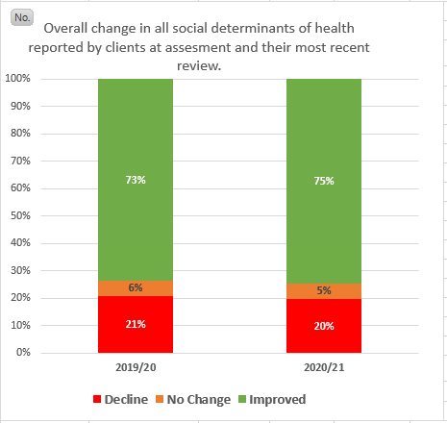
Social Determinants
Notes:
Figure 7 shows where people report improvements in various social determinants of health. The biggest changes are in:
Mental health
Physical health
Being connected
Staying in Work
People have experienced the least change in their view of how in control of their housing and money they are, although the more people are seeing positive than negative change in these areas. Issues such as housing stock availability and the quality of private sector rentals; or low wages and insecure working conditions are a consistent and ongoing force in the lives of many of the people and communities who use the service. Whilst we can have little immediate impact on these wider issues, we can and do support people to challenge housing bandings and to develop skills, interview techniques, and to improve their CVs.

Slide 18
Goals
Notes:
know anecdotally and from case-management discussions that many others have partially completed their goals. For example, if someone’s goal is to go to the gym three times a week and they go twice, this would be classed as an incomplete goal. One of the pieces of learning from this review is to develop the dataset related to goals more fully so that this impact can be captured and described. Especially since, as people are free to define the scope of their goals, many of the partially complete goals may be those with a greater number of steps.
Figure 10 shows that most people with Be Well set more than one goal with the service. The group who set no goals are those who:
Only have had one session with the service.
Were supported during the first lockdown with immediate welfare needs only.

Slide 19
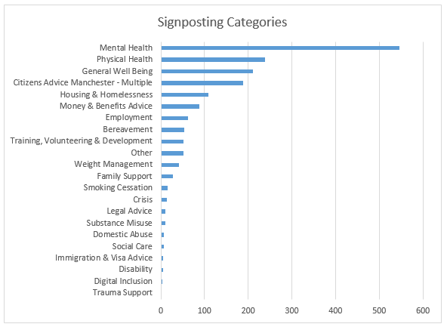
Connectivity out
Notes:
Figures 2 & 3 provide an overview of the services and service types of referrals and signposts made by the Be Well services. The difference between a referral and a signpost is that a referral is done via a formal route. The majority of referrals are to Mental Health providers. We have referred to 117 different organisations across Manchester highlighting the wide range of services our link workers and coaches have built relationships with. In addition to this, Figures 4 & 5 show that we have signposted to 150 different organisations across Manchester.

Slide 20
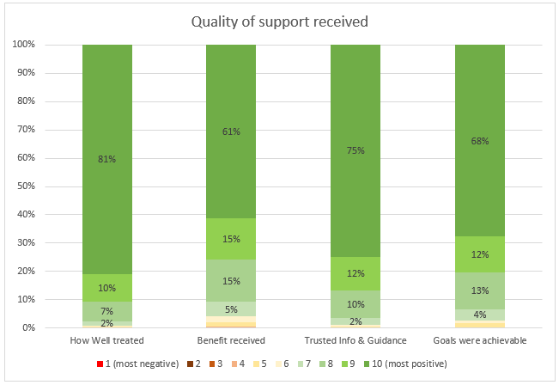
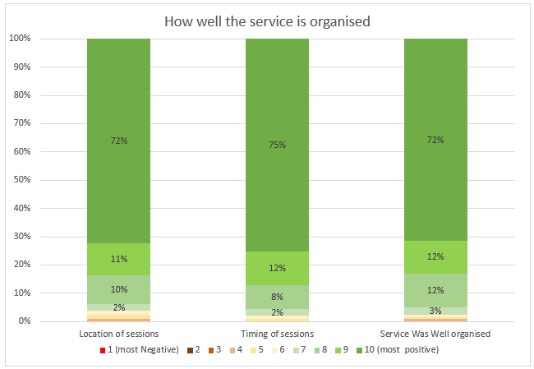
Satisfaction

Slide 21
Lots of partnership work….
Be Well Partnership
“The story captured by the interviews is one of a successful partnership, built on shared values and appropriate leadership behaviours in everybody. The partnership has learnt together, supported delivery of an effective service, and responded to crisis rapidly”
Integrating Fit For 4 Work into Be Well
Integrating CAM into Be Well
MLCO Neighbourhoods
“The Be Well service are key partners for MLCO neighbourhood working. They refer patients into our Care Navigators to the Co-ordinated Care Pathway and accept referrals when social prescribing is appropriate from the Integrated Neighbourhood Team. Be Well link workers and coaches are members of our Neighbourhood Partnership Groups and also form part of the Frontline Workers Groups led by the Health Development Co-ordinators in our twelve neighbourhoods
Notes:
80% of residents have retained their employment status either with current or new employer whilst in receipt of support from In-Work support
1399 interventions to 1249 clients
Resolved 3497 issues (avg. 3 issues per client)

Slide 22
Continued….
Nesta Challenges
North Manchester Development work
Youth Social Prescribing
Tier 2 Weight Management
Primary Care Relationships
GM Social prescribing
Mental Health Pathways
Public Health Pathways
Connection with Childrens Services - Alonzi Hub
Notes:
80% of residents have retained their employment status either with current or new employer whilst in receipt of support from In-Work support
1399 interventions to 1249 clients
Resolved 3497 issues (avg. 3 issues per client)

Slide 23
COVID-19
National Lockdown 1 – March 2020
New element service Be Well North
PCN Social Prescribing Team
Opened up referral pathways
COVID Specific Reporting – mental wellbeing, isolation strategies and food
Employment
Less contact with our local community services
Notes:
Be Well remained open for referrals during the first lockdown with relaxed eligibility requirements that meant any organisation was able to refer people into the service.
We were able to immediately move to offer telephone support and the service adapted to support people with COVID-19 related needs - and people’s immediate welfare. We also started supporting people with a greater frequency and didn’t close people from our client management system unless they asked us to no longer contact them. Be Well worked with partners across the city to be part of a community response team for the most vulnerable, which involved providing support around the delivery of medication and food parcels within communities.
During the first few months of the pandemic, we worked with people in a slightly different way. We adapted quickly to this and captured this work through additional reporting.
We have mapped the support that is currently available from other services and community providers, along with their response plans to COVID 19. This has ensured that our staff know where they can signpost and link people to during this period. This is a living document which is constantly updated as we become aware of any changes.
We now receive a list of vulnerable people monthly from the food response team at the City Council. These are people they feel need support above and beyond a food package.
We are also supporting at COVID vaccination sites across the city and contacting those who may want more information about, and support to access the vaccination.
Moving forward our team will be contacting people in cohorts 1-4 who haven’t yet had the vaccine, to support practices with education and myth busting.
Employment
It has been much harder for our out of work team to help people secure employment during the Pandemic. Our in-work team have also noted that more patients referred are reporting a greater level of need for specialist support, particularly mental health. This trend started at the start of the pandemic and has increased over the past six months – leading to an increased demand for counselling/psychological intervention. We are currently working on a project to add e-therapies including mindfulness to our suite of intervention in order to take pressure off the mental health team and build resilience/self-care strategies for patients. The programme has seen an increase in referrals for residents of Manchester who work within the NHS during the pandemic.

Slide 24
Learning
Workforce Development is key
Two Tier Support System
Characteristics of the cohort and analysis of WEMWBS.
One Social Prescribing system for the city
Covid 19 Recovery
Alignment with community mental health transformation
Social Prescribing Grant Funding – local VCSE services

