Slide 1
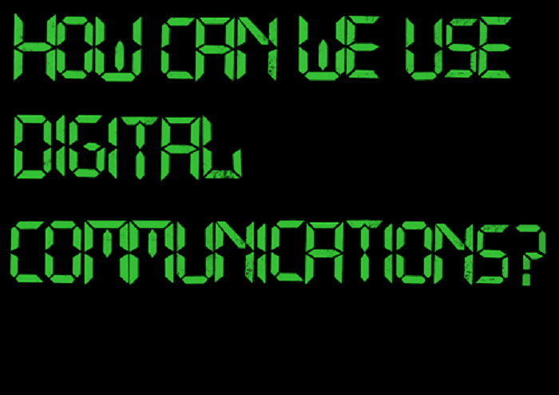
Gathering Stories
#McrVSA

Slide 2
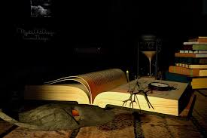
What is a story?
‘An account of imaginary or real people and events told for entertainment.’
‘An account of past events in someone's life or in the development of something.’
https://en.oxforddictionaries.com/definition/story

Slide 3
The purpose of stories Survival! Entertainment Inspiration Education Challenge Motivation
#McrVSA

Slide 4
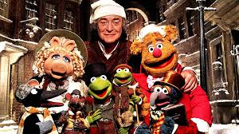
Four story essentials 1) Setting the scene “Marley was dead: to begin with” 2) Crisis / struggle 3) Discovery 4) Change / resolution
#McrVSA

Slide 5
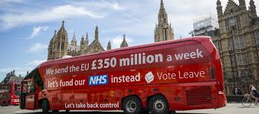
Framing a story Frames will trump facts every time but facts still count!
‘Work is the best route out of poverty’
#McrVSA

Slide 6
Digital stories - Written 1) Spirit Story Week - https://bit.ly/2T9kBmb 2) Mental Health Grants Programme 3) Shelter stories - http://stories.shelter.org.uk/
#McrVSA

Slide 7
Digital stories - Video 1) Time to Change – Ask Twice https://bit.ly/2NdNglV 2) Childline YouTube channel – https://bit.ly/2T9aluo 3) Community Reporters
#McrVSA

Slide 8
Digital stories - Audio 1) The listening project (BBC and the British Library) - https://www.bbc.co.uk/programmes/b01cqx3b 2) John’s Spirit Story - https://bit.ly/2PmWPVH 3) You, Me and the Big C - https://bbc.in/2Fici4p
#McrVSA

Slide 9
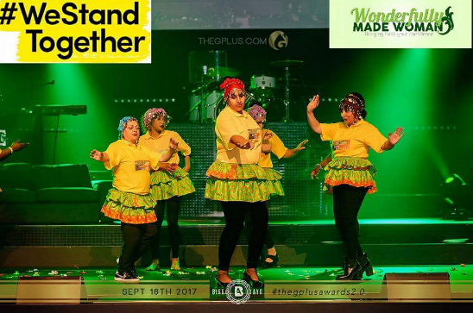
Digital stories - Photographs 1) Unequal Scenes - https://bit.ly/2FfflKP 2) PhotoStories - https://bit.ly/2DAoXOU 3) #CABlive on Twitter
#McrVSA

Slide 10
Gathering stories What are your favourite stories?
#McrVSA

