Slide 1
GM Quality Improvement and Assurance Framework proposal
December 2022

Slide 2
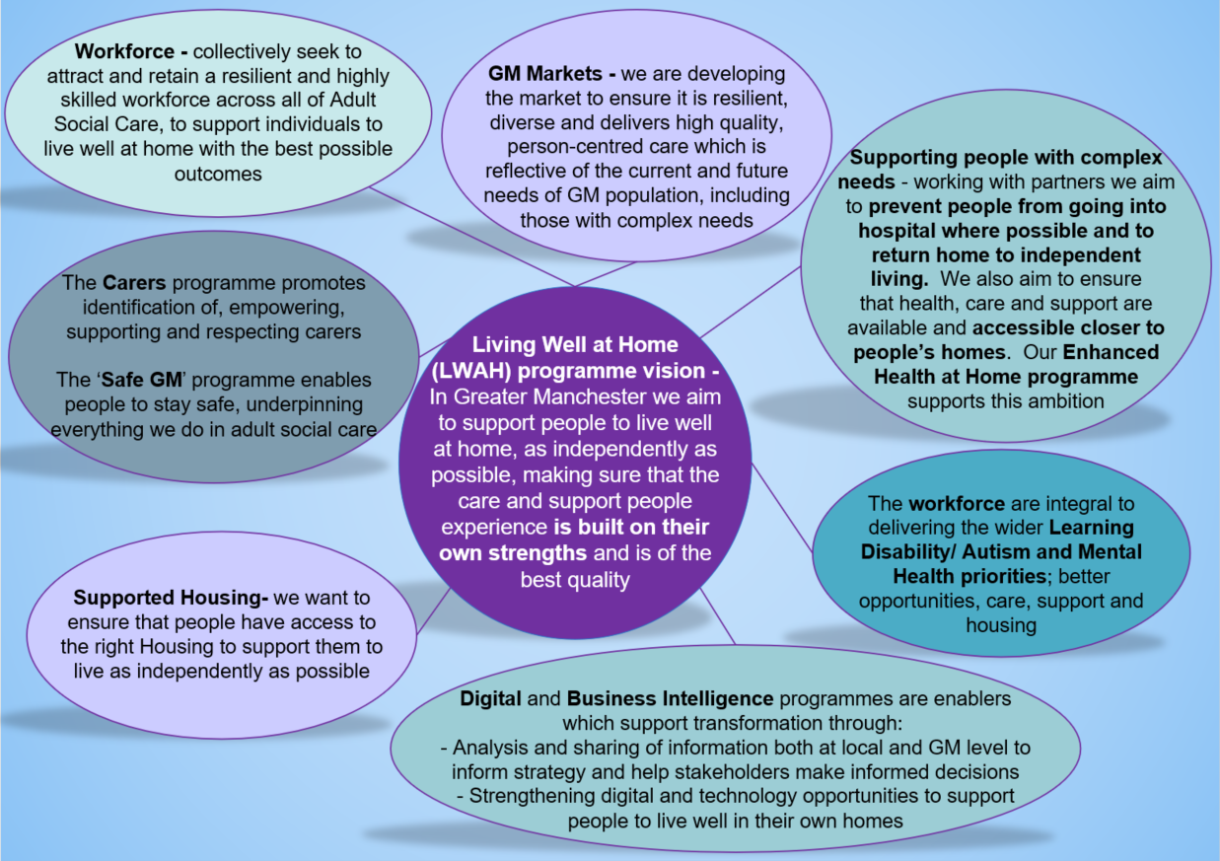
Living Well at Home programme
Greater Manchester Adult Social Care Transformation Programme – Living Well at Home

Slide 3
WHAT IS THE PROPOSAL?
Care providers
Commissioning
Social work
Safeguarding
Governance
To define and develop ‘what great looks like’ in terms of care and support, to support better outcomes for people
To understand local plans, models and systems
A single repository of performance management information and insights
One set of processes and reporting methods
Notes:
Cluster commissioning

Slide 4
WHY ARE WE DOING THIS?
HOW WILL WE DO THIS?
To identify the best quality improvement and assurance models across GM and wider to inform the creation of an exemplar model – to support people to live well at home
Where appropriate offer consistency of quality standards and approaches across GM (note this is not a one size fits all – its about standards not standardisation)
So we are in the best possible position in preparation for the new CQC assurance process starting in April 2023
Through co-production, with commissioners, providers and those with lived/living experience
PURPOSE
GM’s Living Well at Home programme includes a Quality Strategy, which strives for high quality, outcome-focussed and person centred care and support, which is based on people’s strengths. The framework will define what we consider ‘great’ to look like, provide a tool to identify areas of best practice from which we can drive continuous improvement across GM.
Notes:
Cluster commissioning

Slide 5
DISCOVERY SESSIONS
Living Well at Home programme
We would love to hear what people who are receiving or have received care and support think great quality looks and feels like
Have you experienced great quality?
What made/makes the biggest difference from your point of view?
Are you currently asked about your quality of experience from providers or commissioners?
If you would like to take part in a 1 hour discovery sessions to share your experience and inform what the GM framework will look like? If so please email debra.ward9@nhs.net
Notes:
Cluster commissioning

