Slide 1
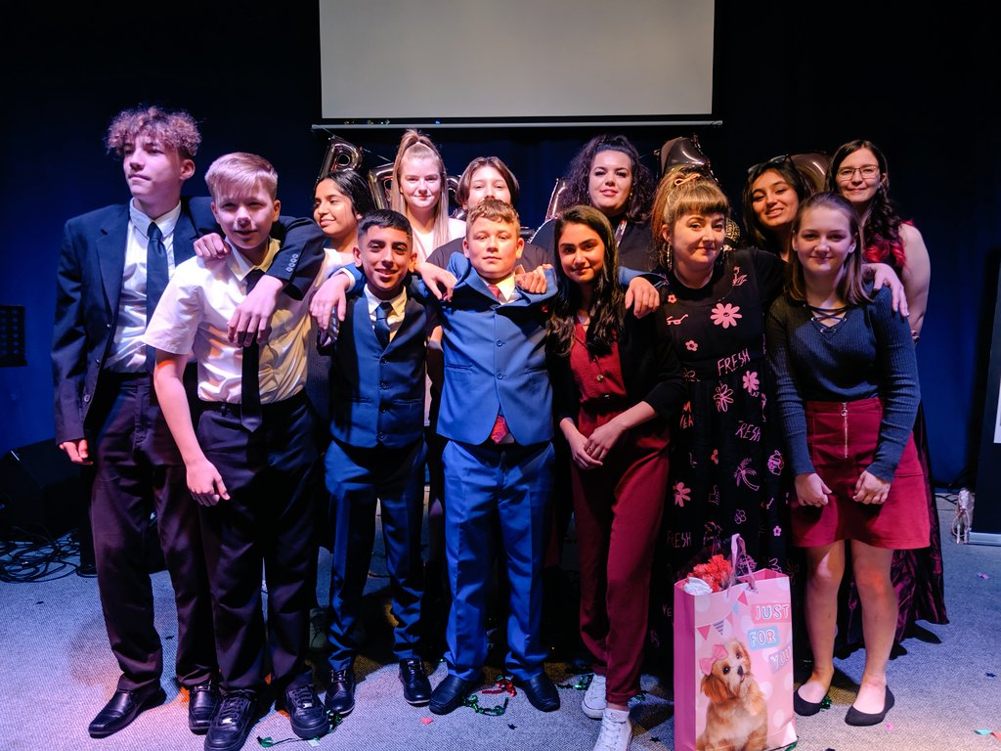
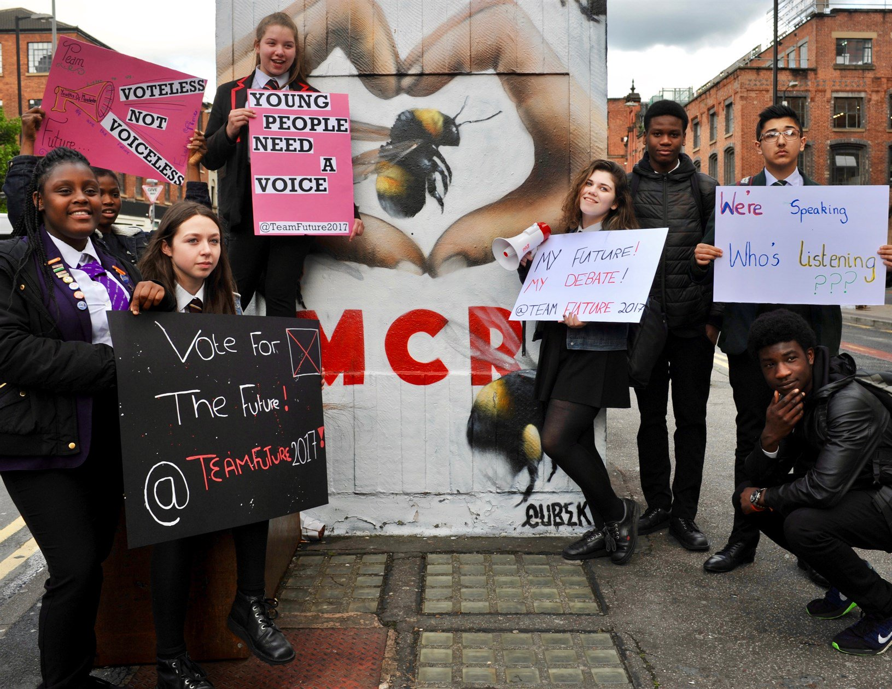
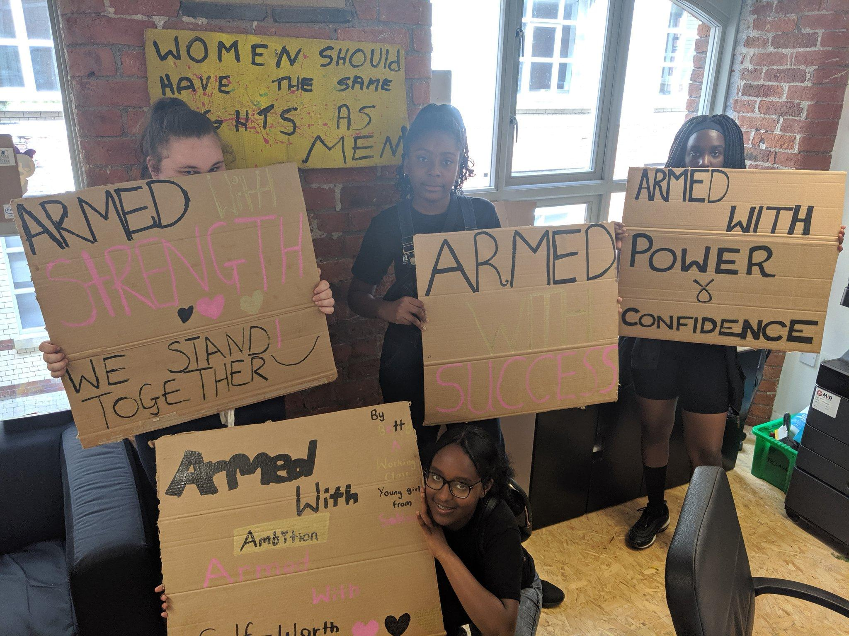
Investing in Young People as Future Leaders

Slide 2
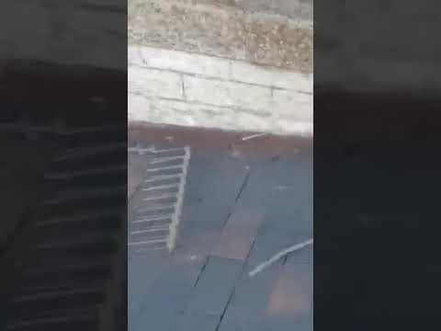
A quick introduction...
Notes:
Barrier remover
People connector
Opportunity seeker
Conversation starter
Passionate about all young people reaching their potential, regardless of their background

Slide 3
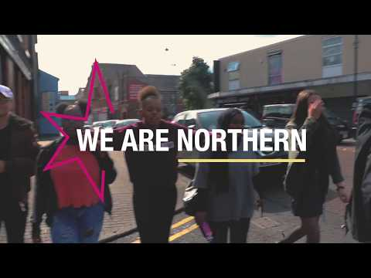

Slide 4
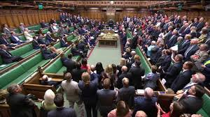
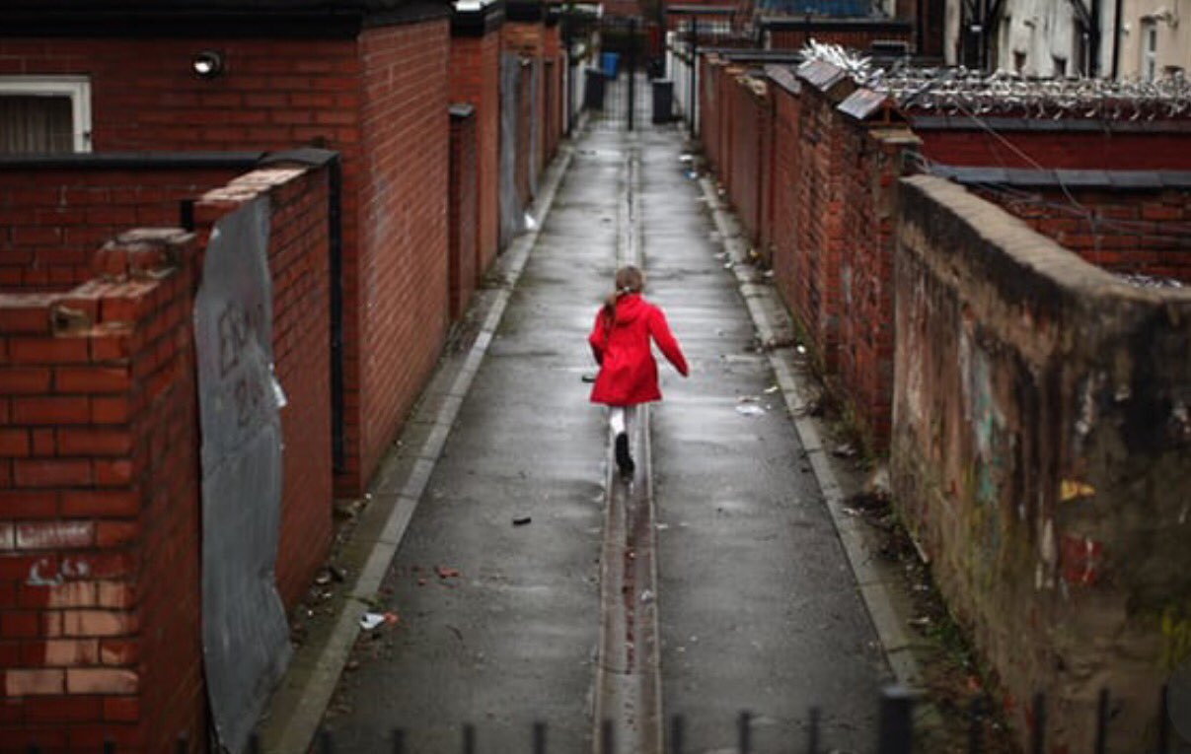
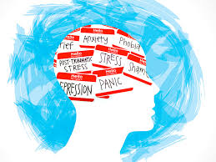
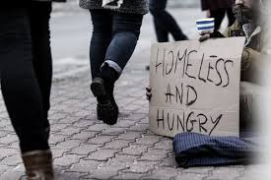
What are young people worried about?
Notes:
Brexit - Votes at 16 and Political Education
House of Commons - Behaviour of MPs
Media representation of Working Class - #WorkingWithClass
Mental Health - #TalkToUsStayWithUs
Climate Change - School strikes and consequences for young WC people

Slide 5
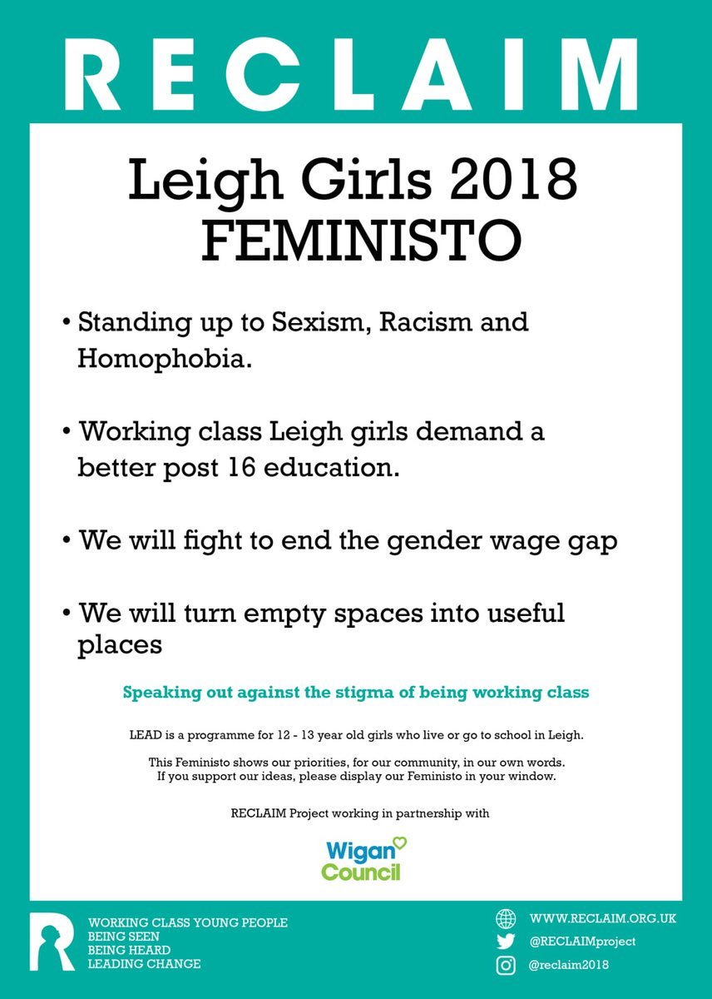
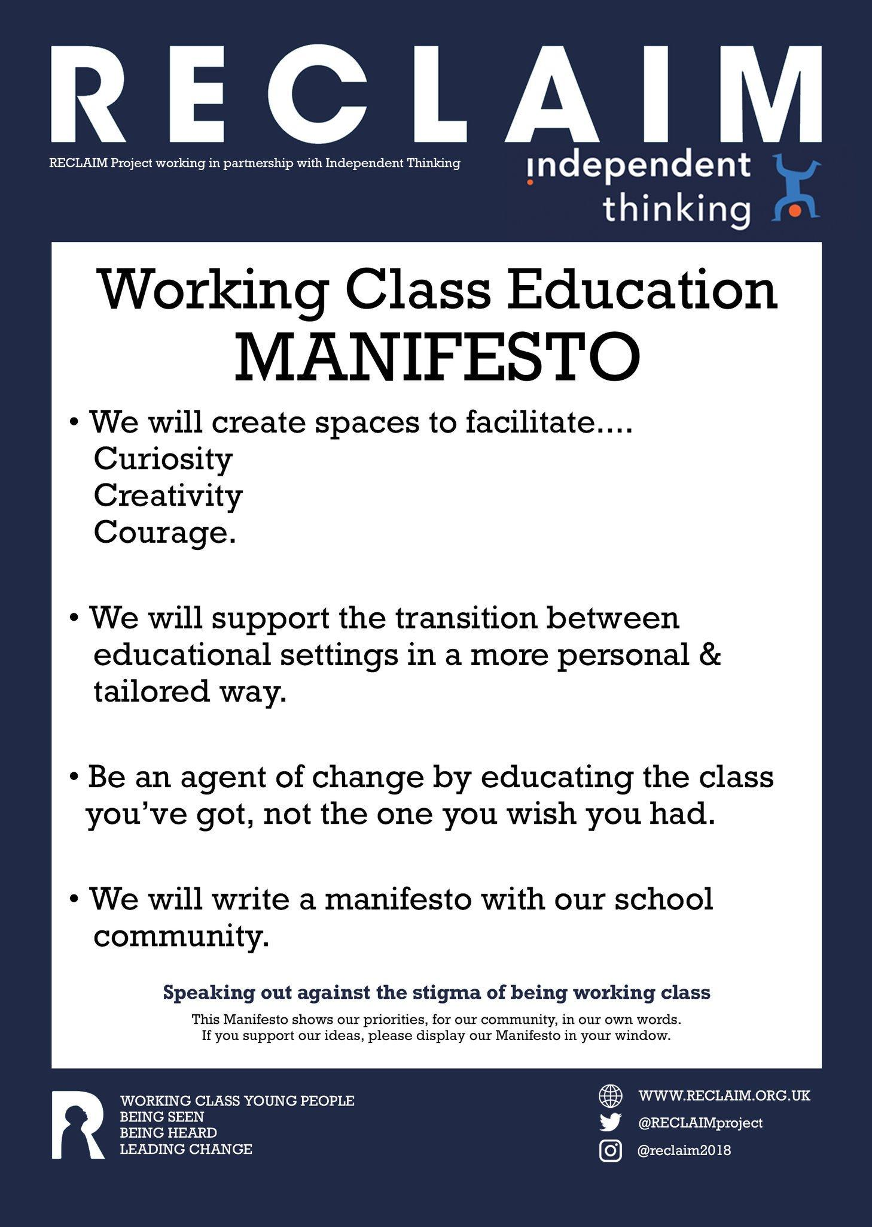
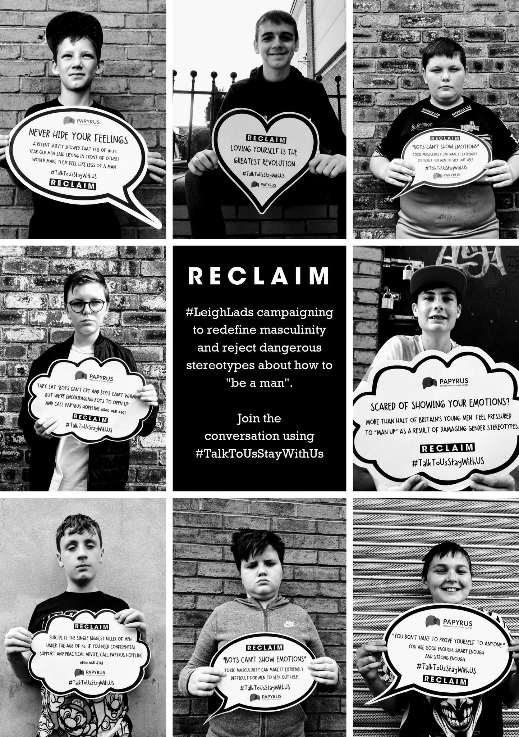
What are young working class people in GM worried about?

Slide 6
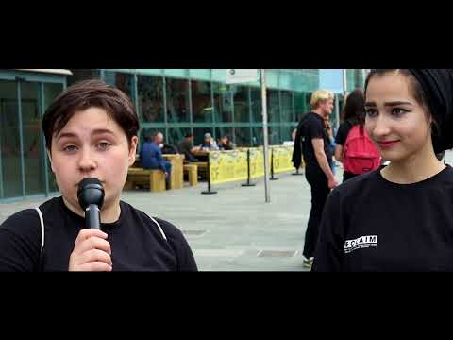
What are young people doing about it?

Slide 7
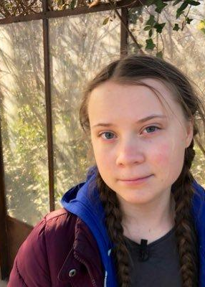
Environ-
mentalist
Campaigner
Activist
UN Speaker
Author
GRETA, 16

Slide 8
Activi
Activist
Nobel Prize Winner
Charity Founder
Survivor
MALALA, 22

Slide 9
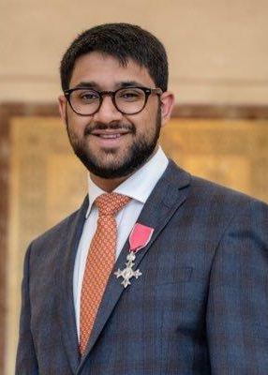
MBE
Charity CEO
Deputy Lieutenant
Social Mobility Commission
SAEED, 22

Slide 10
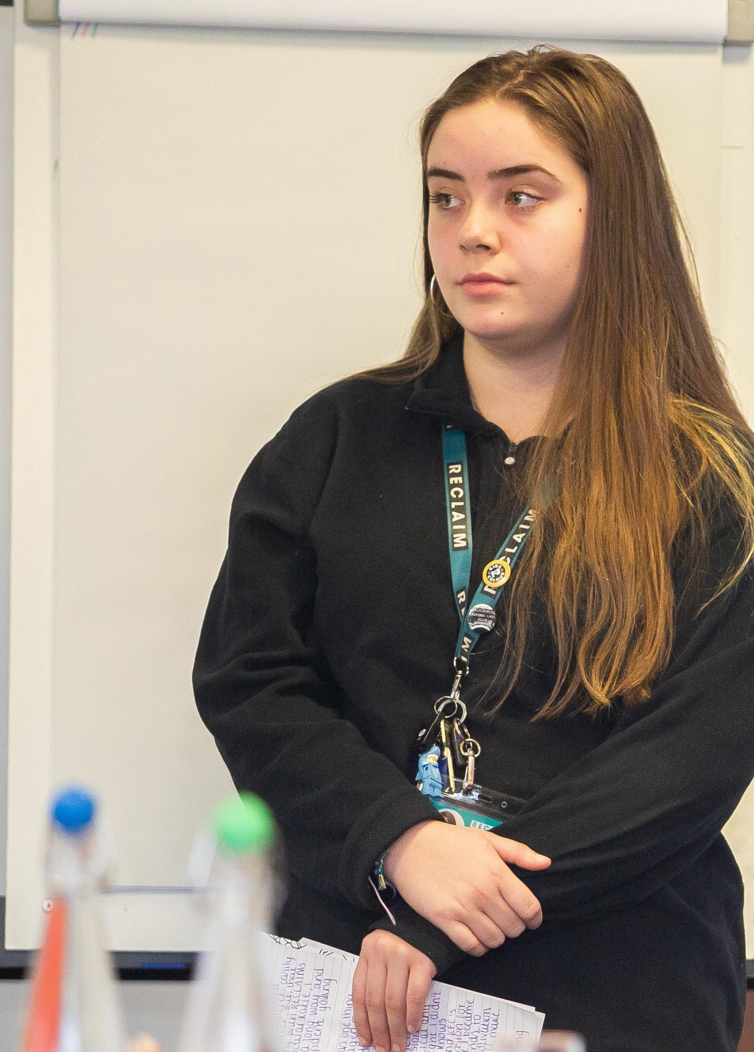
LEAD graduate
Activist
Adviser to Andy Burnham...
OLIVIA, 17

Slide 11
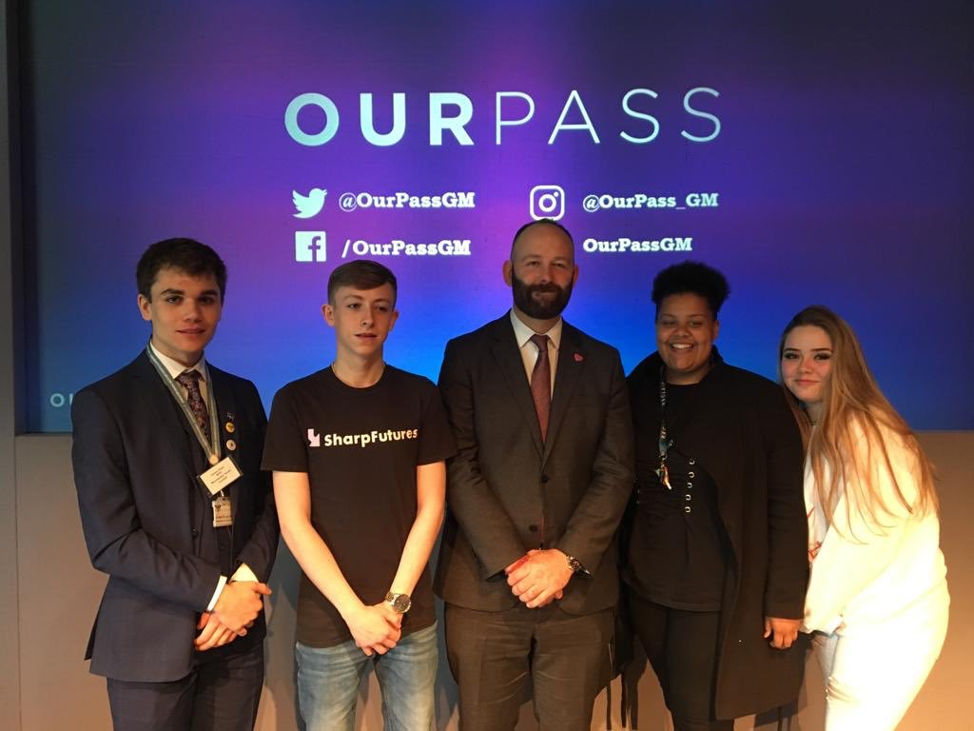
When adults listen: Olivia and ‘Our Pass’
“Olivia is actually the reason that ‘Our Pass’ came about - it came from a conversation that I had with her.”
Andy Burnham,
Mayor of Greater Manchester

Slide 12
What can adults do?
Invite Young People In - If it’s about them, then it should include them
Make it accessible -After school, pay for travel… Or go to them!
Incentivise - Outline the ‘What’s in it for me?’ factor
Present, don’t represent.
Do it properly, or not at all. No Tokenism, please.
Notes:
Work Experience
Youth Board
Volunteer
Always ask where the voice of young people is, at every table
Listen to your own children

Slide 13
What are you going to do?
Write down 3 things that you will commit to that will:
Ensure that young people are authentically heard in your organisation.
Contribute to supporting young people in your local community.
Maximise the opportunities for young people from ALL backgrounds to engage and experience your organisation.

Slide 14
What can RECLAIM do to help?
Run workshops and training sessions with your team.
Help you to engage and build youth voice within your organisation.
Support your recruitment/intern processes to ensure that all young people get the fairest opportunities.
Work with you to design a mutually beneficial work experience programme.
Provide you with a consultancy service that can audit current practice, leading to recommendations on how to best support young working class colleagues.
Offer you and your colleagues volunteering and mentoring opportunities, as well as CSR partnerships for your organisation

Slide 15
We have a powerful potential in our youth, and we must have the courage to change old ideas and practices so that we may direct their power toward good ends.
~ Mary McLeod Bethune
Notes:
Mary Jane McLeod Bethune was an American educator, stateswoman, philanthropist, humanitarian, and civil rights activist best known for starting a private school for African-American students in Daytona Beach, Florida and co-founding UNCF on April 25, 1944 with William Trent and Frederick D. Patterson.

Slide 16
What can adults do?
We can listen.
And we can act upon what we hear.
We can share the power.
We can shape the future, together.
Notes:
Work Experience
Youth Board
Volunteer
Always ask where the voice of young people is, at every table
Listen to your own children

Slide 17
Website: www.reclaim.org.uk
Twitter: @RECLAIMproject
Facebook: @RECLAIMproject
Instagram: @reclaim_project
Youtube: RECLAIMManchester
Email: b.bainbridge@reclaimproject.org.uk
Telephone: 0161 806 0665

