Slide 1
The Change Project. A Project Of The ACCORD Program.
Zoe Manley
Therapeutic Project Worker
zoe@thechangeproject.org.uk
0161 327 0176

Slide 2
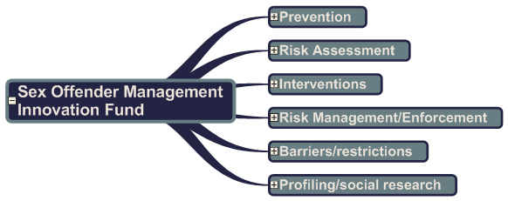
The ACCORD Program.

Slide 3
The Change Project: Mission Statement
To highlight and educate individuals and communities of the destructive impacts of sexual abuse, in order to create positive change and develop informed treatment pathways to prevent future victims.

Slide 4
The Change Project: Aims
To develop and provide trauma informed support and treatment interventions to male survivors of sexual abuse, rape and sexual exploitation who have committed or at risk of committing sexual offences
To educate professionals in the complex work involving the sexual offending behaviour of male victims of sexual abuse, rape and sexual exploitation
To highlight the destructive nature of sexual offences to young people, in order to prevent future victims and offenders.
To change perceptions of male sexual abuse in order to create viable strategies to prevent future victims and offenders.

Slide 5
The Change Project: Services
Trauma Informed Clinical Treatment and Support Services: Counselling & Psychotherapy. Focus on childhood trauma and CSA. Incorporating psychosexual aspects of offending behaviour and offering intervention such as relapse prevention, impulse control, urge reduction.
Young People’s Interactive, educational workshops: offering education and raising awareness of sex offending and the law. Sexting, revenge porn, consent, pornography, CSA, male sexual abuse.
Professionals Training Workshops: The psychology of sex offending through the eyes of the victim. Informed training responsive to the evolving nature of sex offending behaviours and trends particularly specific to Greater Manchester populations.

Slide 6
Young People’s Workshops
Preventative measure for those aged 13-18
Single sex groups at an hour long
We provide facts and advice on how young people can keep themselves safe and try to equip them with the facts they need in order to make informed decisions around sex
Topics we cover include; consent, sexting, revenge porn, grooming and healthy relationships
They are completely free
They are interactive in nature and promote discussion

Slide 7
Young People We Work With
Although ALL young people are vulnerable to CSA/CSE we work with those who lack protective factors. These may be:
Those from chaotic and/or traumatic backgrounds
Those not engaging with mainstream education
Those who have difficulty maintaining and developing relationships
Those with additional learning needs
Those with social, emotional and behavioural issues
Those with distorted views of relationships and intimacy
LOW SELF ESTEEM

Slide 8
Sexting
https://youtu.be/sch_WMjd6go

Slide 9
Sexting
What is sexting?
What could happen?
Who might see it?
What to do if you’re asked
What to do if an image is shared
Legality
Boys

Slide 10
Professionals Training
Discuss male sexual abuse
​​Provide an understanding of the psychology of sex offending
Explore some prominent theories of sex offending
Explore models of childhood sexual abuse
Provide an understanding of developmental risk factors
Facilitate understanding of developmental risk factors
Provide an understanding of potential drivers for online offending behaviour
Facilitate discussion about confidentiality and multi-agency working within the field using clinical case studies​
4 hours long and completely free

Slide 11
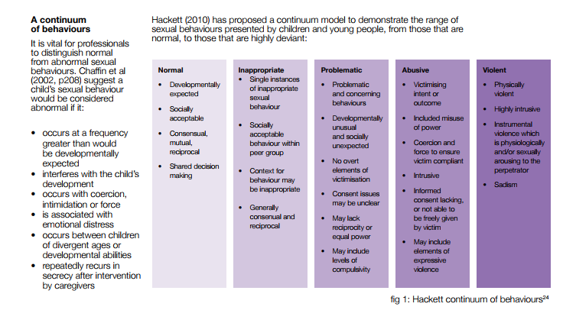
Sexualised Behaviour

Slide 12
Sexualised Behaviour

Slide 13
Prevention

Slide 14
Resources
https://www.thinkuknow.co.uk
http://www.childnet.com
https://www.ceop.police.uk/safety-centre
https://www.youtube.com/user/ceop
https://www.nspcc.org.uk/services-and-resources/research-and-resources/2016/harmful-sexual-behaviour-framework

