Slide 2
The Challenge
Challenges faced in Manchester reflect those elsewhere:
Youth and play sector dependent on public sector funds
Sector is fragmented, lacking infrastructure and capacity to be strategic
Wider financial pressures within the public sector have led to greater expectations on universal services and the third sector
Manchester is a growing, and increasingly young city
The opportunities of a booming city with world class facilities are not open to all

Slide 3
About Young Manchester
Launched in November 2017
Partnership between Manchester City Council, third sector and businesses – owned and led locally
Informed and influenced by the work of John Lyon’s Charity in London
Commission youth and play services, training and capacity building and sector leadership in partnership with MCC

Slide 4
Our vision
Our vision is that every child and young person in Manchester can thrive and realise their full potential through outstanding opportunities.
Manchester is a world-class city for children and young people, where the benefits of economic growth are experienced by all
All children & young people in Manchester have access to high-quality play or youth provision
Manchester has a strong, vibrant and sustainable sector supporting children and young people to be happy, healthy, safe and realise their full potential
Young Manchester is the go-to organisation for all children and young people’s issues and work in Manchester

Slide 5
Guiding principles
Children and young people’s voice – the voices and lived experiences of children and young people will be critical to all our work, and all activity will seek to work with young people, placing them at the heart of the organisation, including our own governance and accountability
Tackling poverty, inequality and exclusion – our work will seek to challenge and address the direct impact of poverty and inequality, as well as seek to understand and tackle the root causes which keep children, young people and their families in poverty, and continue to create an unequal society. Our work will also place significant emphasis on inclusion and equity, ensuring that opportunities are accessible to all, no matter the barriers and challenges that they may face.
Quality and impact – we will ensure that our work is making a difference, and work with partners and stakeholders to build our evidence, demonstrate value and champion the impact that youth and play work has on children, young people and communities.
Partnership – we will prioritise collaboration and collective impact, seeking to work with, and build up, others whilst building strong alliances and networks across the city.
We don’t do direct delivery, focus on collaboration not competition, and focus on long-term sustainable solutions.

Slide 6
Tactics and approaches
Income generation –we bring new money into the city, and ensure that investment in children and young people is coordinated and aligned across Manchester
Funding quality work –we actively provide additional resources for children and young people’s organisations, including supporting organisations and the communities to grow
Championing and awareness-raising –we promote great youth work, great organisations and great children and young people
Convening and networking –we support the building of strong networks of providers, stakeholders and funders across the city to achieve collective impact
Quality and capacity building –we focus on the quality of delivery of youth and play services, and support the sector to growth and thrive with tailored infrastructure support
Innovation, co-creation and development –we support new ideas and approaches which reflect the complexity of children and young people’s lives and seek to make long-term, sustainable change, and which are shaped by the lived experiences of communities

Slide 7
Impact
Provided funding of over £5m to the sector, leveraging core investment from MCC to secure investment from #iwillfund (£2m) and a range of smaller donors, doubling the investment from MCC
Funded work with over 20,000 young people since Nov 2017, over 7,000 of whom have been involved in social action
Created a platform for embedding and sustaining national and local priorities e.g. youth social action, cultural education, detached youth work
Established a network of over 70 organisations across Manchester, facilitating a range of new opportunities for partnership
Led the development of new programmes of work to meet local need e.g. digital skills, arts and culture, holiday hunger, mental health and wellbeing, SEND
Opened new funding opportunities to the sector, directly and indirectly e.g. health and care commission, private sector investment, national contracts
Commissioning role allows us to have direct influence over quality, and shape provision (co-designed with sector and communities)

Slide 8
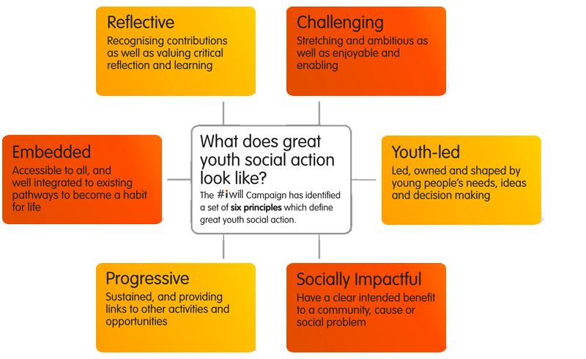
Social Action

Slide 9
Partnerships across the city

Slide 10
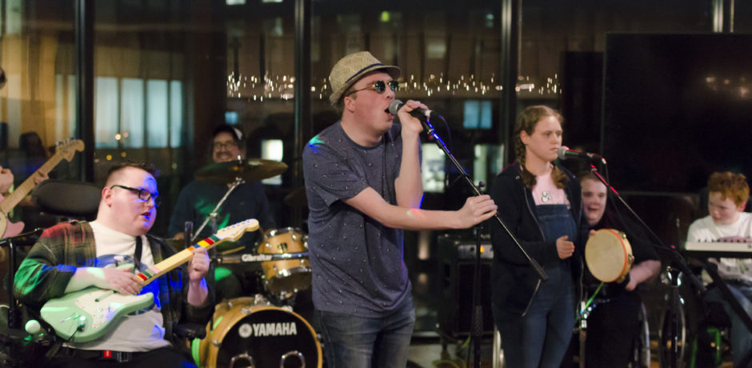
Access All Areas – a programme of high quality creative activities for young people with more complex needs, that build participants’ life and employability skills
House Party - accessible club nights, where young people with disabilities could have equivalent opportunities to party to those of their peers
Seb, aged 24, described the benefits of being involved as having the opportunity to “meet new people, to be creative and to be in charge”

Slide 11
In the last year, 713 young people have engaged in social action across the partnership, with an average engagement level of 23 hours per person.
Wythy Youth Bank – young people making funding decisions for their local community
80 young people across 10 projects taking on leadership roles as ‘Junior Playworkers’
Progression into senior volunteer roles, work experience and apprenticeships

Slide 12
Future Plans
Youth violence fund and partnership work across in Manchester
New Youth and Play Fund launched in October 2019
Build sector leadership and partnership working
Supporting development and implementation of new MCC Youth Strategy
Informing national policy to invest in local models and organisations
Build private sector engagement with youth and play organisations in Manchester

Slide 13
Questions / discussions
What great work with children and young people have you seen (locally or through your organisation), and what made it great?
What do you want to see more of for children and young people in Manchester?

